Slide 1

Software Engineering (CS3201) Introduction to Software Engineering
Avinash

Slide 2




name: Hello World CI
jobs:
build:
runs-on: ubuntu-latest
steps:
- name: Checkout code
uses: actions/checkout@v2
- name: Print Hello World
run: echo "Hello, World!
Avinash, Assistant Professor at Mahindra University
Alumnus of Hyderabad Central University and IIIT-Hyd.
Industry experience: SalesForce, MAQ Software, NTT Data
Mobile Application Dev; Senior Analyst
Research Experience: Wireless Sensor Networks (PhD)
Contact: avinash.chauhan@mahindrauniversity.edu.in
Office time: 2:30 – 4:30 [Wed]; Location: IT2 block, FF, cabin-17
Passionate about The Cosmos, Whales, Photosynthesis, Skies and sunshine, Wireless Sensor Networks, Minimalism (as a way of living), Nematodes, Bilaterians, and a whole lot more...
Note: No one has vandalized this image.
Avinash

Slide 3
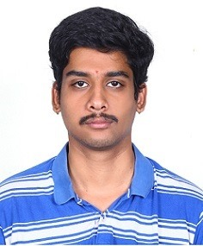
Teaching Assistants
PhD TA:
MTech TAs:
Priyanka Seelam (se25maid006@mahindrauniversity.edu.in ) Mahesh Mannava (se25maid037@mahindrauniversity.edu.in )
Tanniru Varun (se25maid009@mahindrauniversity.edu.in )
Guggilla Rishitha (se25maid025@mahindrauniversity.edu.in )
THONTI SIDDHARTHA (siddhartha20ucse210@mahindrauniversity.edu.in )
Polineni Harshini S (se25maid003@mahindrauniversity.edu.in )
Surya Phani Teja
se23pcse001@mahindrauniversity.edu.in

Slide 4
Course overview
Introduction (to Software Engineering)
Software Development Life Cycle (SDLC)
UML Methodology
Design Patterns
Software Architecture and Maintenance
Software Quality and Management
"The last thing you figure out in writing a book is what to put first." - Pascal

Slide 5
Course outcomes
CO1 | Learn the importance of software engineering and processes.
CO2 | Apply software development lifecycle (SDLC) process to a software project.
CO3 | Apply software engineering tools and techniques for requirements analysis, design, and documentation
CO4 | Develop high quality software within time and budget estimates.
CO5 | Ability to monitor software quality at various stages of SDLC

Slide 6
When do we meet?
2 lectures per week
Mon [10:35 – 11:30], Wed [10:35 – 11:30]; ELT-2
1 lab per week
Tue [8:25 – 10:20]; IT2 block, GF and FF2 (tentative)
Course Assignment, Lab Submissions and Project: Piazza/ Google Forms
It is mandatory to attend all the exams and submit all assignments on time
Please try to contact via email before meeting (unless within office hours)
Mandatory to attend major exam to get pass grade

Slide 7
Course policy
Attendance is mandatory and QR based, however smart phones should be in Silent mode
Texting and use of phone (other than attendance) is prohibited
Zero tolerance to plagiarism
No alternate tests for missing minors (recent notification by Admin)
Attendance of 75% and GPA of 4.0 minimum to pass/ promote

Slide 8
Course policy
"Missing Minor exams will not be given re-test. If a student misses it due to genuine and verifiable reason(s), she/he will be given weightage for the missed exam(s) on a pro-rate basis of performance in the end-sem exam.“
"Furthermore please tell them that in a supplementary no grade better than grade “D” can be obtained. However if a student carries an “I” (standing for incomplete grade) given in an individual course, the student will get regular grade as earned in the supplementary exam."

Slide 9
Evaluation / Grading policy
Internal Evaluation / Lab (20%)
Individual Lab Assignments: 20%
Term Project (20%)
(Group of 4-6*): 20%
External Evaluation (60%)
Minor 1 + Minor 2: 25% (12.5 + 12.5)
Major: 35%

Slide 10
Course content (One Drive and Piazza)
The following content is available here: Course Content
Lecture Slides
Lab Exercises and Assignments (to be added)
Textbook* (expected to at least read certain sections from these books)
Software Engineering – Ian Sommerville, 10th edition, Pearson Education
Software Engineering: Principles and Practices - Hans Van Vliet, 3rd Edition, Wiley publications
Reference textbooks*:
Software Engineering, A practitioner’s Approach - Roger Pressman, 8th edition, McGraw Hill International Ed.
Software Engineering – Pankaj Jalote
Design Patterns: Elements of Reusable Object-Oriented Software - Grady Booch, Eric Gamma
Other material (as and when added)
Signup (Piazza discussion and help forum): Signup (ignore if signed in via email)
Course Page (Piazza discussion and help forum): Course Page

Slide 11
Course content / Syllabus
Details can be found here: First-Day-Handout (CFA3).docx
Handout will also be emailed to you at the end of today's class (first class)

Slide 12
How to get the best grade?
*more than the end product (working code/ executable), the project will focus on the process, the journey more than the destination
Be friends with the instructor?
Participate in class discussion (maybe)
Be well versed with class slides (minimum)
Complete all (lab) Assignments
Complete each component of course project
Technical writing and documentation will also be tested here
Understanding each phase of project will be tested here
Exams, of course (each minor covers 5 weeks of syllabus, so easier option?)
Reading textbook (certain sections of it)
Programming skills (for the project*)
BE PROACTIVE (Find solutions to problems – once in the industry, you are expected to use the Internet to find solutions to issues in software engineering)

Slide 13
Purpose of term project
Your ability to work as part of team​
Get familiar with entire software development life cycle starting from requirements gathering phase to project delivery​
Remember that in a real-life job (university is not real? A matrix? An alternate dimension?), you will be spending as much as 70% of your time in understanding user requirements, project design and documentation​
Note: Programming Language workshop lab will also focus on Software Engg. course project
The list of projects to choose from is available here: Course Projects
Register your project team here: Registration form link will be sent in due course
Update 1: You can suggest your own project idea (pending a discussion/ brainstorming with me)​
Update 2: I will float a Google form for 'Project Registration' by end of week 1​

Slide 14
Project deadlines (tentative – subject to minor exams)
Jan 28th: Team Registration
Feb 6th: Statement of Work
Mar 6th: Software Requirements Specification
Apr 1st: Software Design Document
May 1st: Software Test Plan
May 4th to May 8th: Project Demos

Slide 15
Your expectations from the course (and how can I help?
Easiest slide to prepare!
Maybe it is too early to ask this question? Remember, you can approach me anytime regarding anything related to the course (or anything, as long as you think I can help)

Slide 16

A software development joke?
Source: Fandango.com

Slide 17
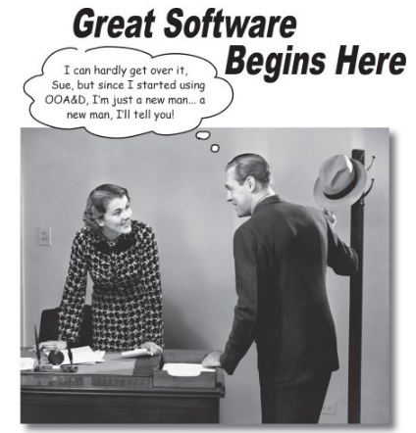
Under the auspices of NATO, two conferences were devoted to the topic in 1968 and 1969 (Naur and Randell, 1968), (Buxton and Randell, 1969). Here, the term ‘software engineering’ was coined in a somewhat provocative sense. Shouldn’t it be possible to build software in the way one builds bridges and houses, starting from a theoretical basis and using sound and proven design and construction techniques, as in other engineering fields?
Introduction
Notes:
#1 is not a great start

Slide 18
Introduction
Lots of people write programs
However, most software development is a professional activity in which software is developed for business purposes, for inclusion in other devices, or as software products such as information systems, word processors, or air traffic control systems
The key distinctions are that professional software is intended for use by someone apart from its developer and that teams rather than individuals usually develop the software. It is maintained and changed throughout its life
Notes:
#1 is not a great start

Slide 19
Introduction
The economies of ALL developed nations are dependent on Software
More and more systems are software controlled
Software Engineering is concerned with theories, methods and tools for professional software development
Expenditure on Software represents a significant fraction of GNP in all developed countries
Point being, Software Engineering IS A BIG DEAL
Notes:
#1 is not a great start

Slide 20
Software Engineering
Software engineering is intended to support professional software development rather than individual programming
Includes techniques that support program specification, design, and evolution, none of which are normally relevant for personal software development
Many people think that software is simply another word for computer programs. However, when we are talking about software engineering, software is not just the programs themselves but also all associated documentation, libraries, support websites, and configuration data
Notes:
#1 is not a great start

Slide 21
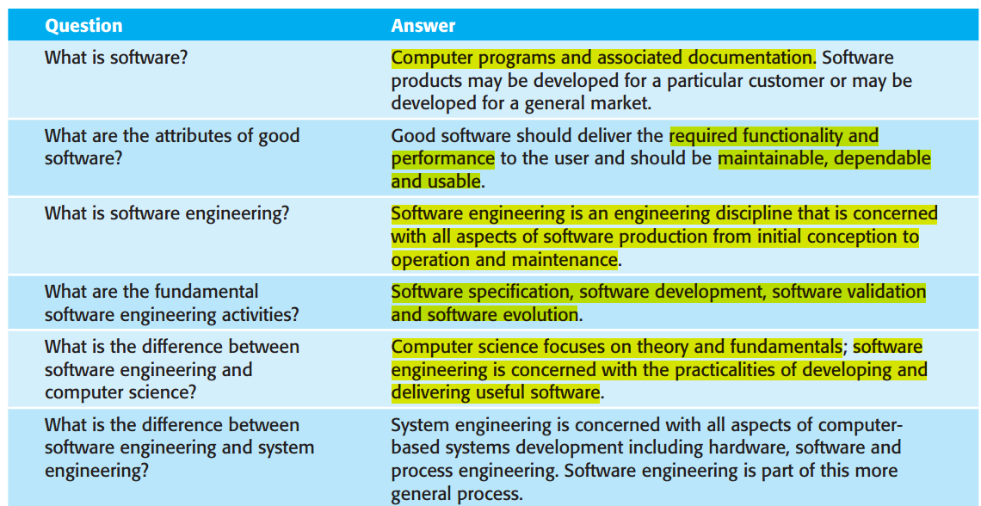
FAQs
Notes:
#1 is not a great start

Slide 22
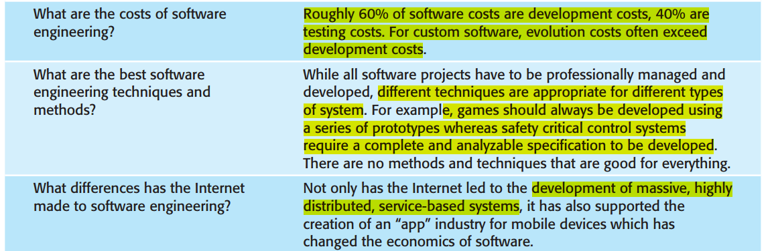
FAQs
Notes:
#1 is not a great start

Slide 23
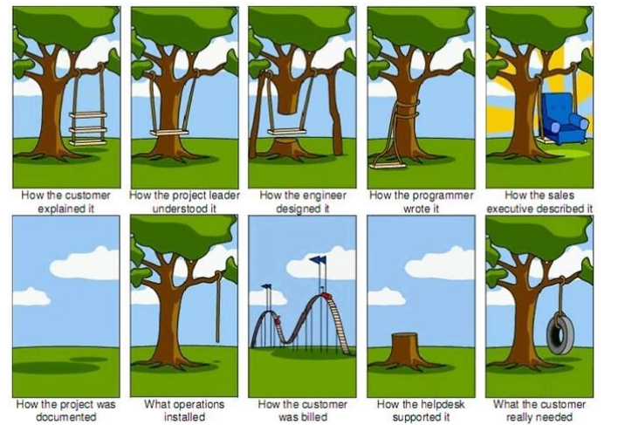
Project Lifecycle (clichéd but valid)
Clichés exist for a reason.

Slide 24
Software Products
Software engineers are concerned with developing software products (software that can be sold to a customer).
Kinds of Software Products:
Generic Product: These are stand-alone systems that are produced by a development organization and sold on the open market to any customer. Example: MS Word
Customized (or bespoke) Product: These are systems that are commissioned by and developed for a particular customer. Example: Custom ERP, ATC software
The important distinction between the two is that in Generic software, the software specification is controlled by the organization that develops the software, whereas in the second case, the specification of the software is controlled by the client or the customer buying the product (how can this be a challenge?)
Notes:
#1 is not a great start

Slide 25
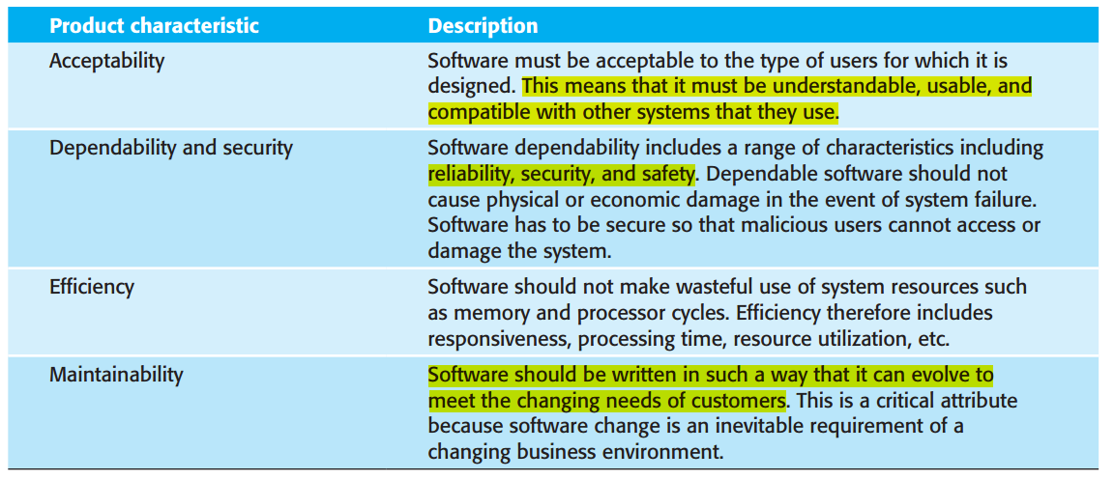
Essential attributes of Good Software
Notes:
#1 is not a great start

Slide 26
Software Engineering, more formally
"Software engineering is an engineering discipline that is concerned with all aspects of software production from the early stages of system specification through to maintaining the system after it has gone into use" (Ian Sommerville, 10th Edition)
Two key aspects here:
Engineering discipline: Using appropriate theory and methods to solve problems bearing in mind the constraints and costs (Engineering is about getting results of the required quality within schedule and budget)
All aspects of software production: Software engineering is not just concerned with the technical processes of software development (design and code), but also activities such as software project management and the development of tools and methods in various phases of software production
Notes:
#1 is not a great start

Slide 27
Software Engineering v. Physical Engineering
Physical systems are often continuous in the sense that small changes in the specification lead to small changes in the product. This is not true with software
Small changes in the specification of software may lead to considerable changes in the software itself
In a similar way, small errors in software may have considerable effects. The Mariner space rocket to Venus, for example, got lost because of a typing error in a FORTRAN program (Read here)
In 1998, the Mars Climate Orbiter got lost, because one development team used English units such as inches and feet, while another team used metric units (Read case study: Lost in Translation – no, not the 2003 Sofia Coppala film)
Notes:
#1 is not a great start

Slide 28
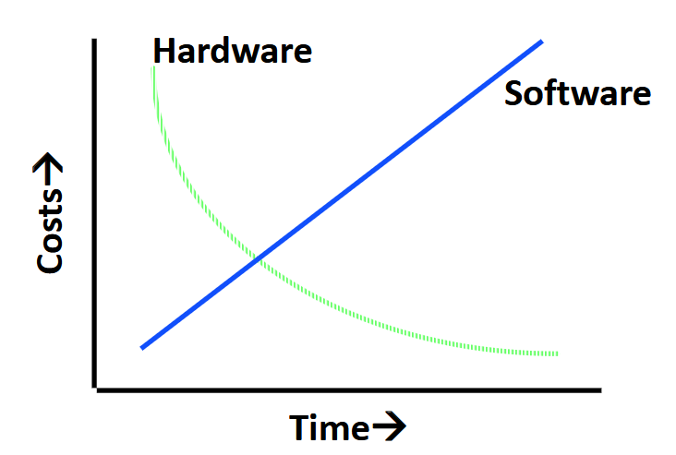
Hardware versus Software costs
We are reaching the end of Moore’s Law (Read here), but hey innovation is expected to continue in hardware, of course (One example here)
Notes:
Moore’s Law (Hardware) versus inflation, i.e., cost of workforce over time, maintenance of software, licensing fee that needs to be renewed, new features like AI integration (Software)

Slide 29
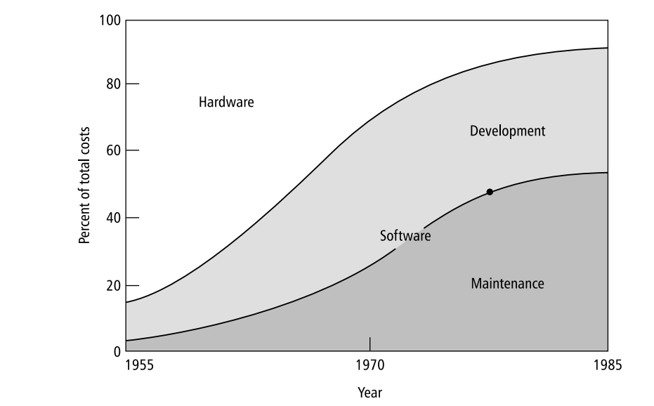
Hardware versus Software costs
Initially, programs were in a limited domain, custom built to suit niche requirements; but in time, computers became ubiquitous and user range greater, and with more real-world incorporation, needs and requirements became more dynamic.
Relative distribution of hardware/software costs (Source: B.W. Boehm, Software Engineering, IEEE Transactions on Computers, 1976 IEEE
Notes:
Moore’s Law (Hardware) versus inflation, i.e., cost of workforce over time, maintenance of software, licensing fee that needs to be renewed, new features like AI integration (Software)

Slide 30
Size of programs continues to grow
Trivial: 1 month, 1 programmer, 500 LOC,
Intro programming assignments (???)
Very small: 4 months, 1 programmer, 2000 LOC
Course project
Small: 2 years, 3 programmers, 50K LOC
Nuclear power plant, pace maker
Medium: 3 years, 10s of programmers, 100K LOC
Optimizing compiler
Large: 5 years, 100s of programmers, 1M LOC
MS Word, Excel
Very large: 10 years, 1000s of programmers, 10M LOC
Air traffic control,
Telecommunications, SpaceX

Slide 31
More challenges
Software cannot be built fast enough to keep up with
Hardware advances
Rising expectations
Feature explosion (why though? Human avarice?)
Increasing need for high reliability software (as software becomes integral in our lives)
Software is difficult to maintain, “aging software” (see notes)
Difficult to estimate software costs and schedules
Many projects fail
Mars Path finder stops due to a simple priority inversion error (Read here)
Many projects get delayed or recalled
Boeing 737 Max got recalled – issues with MCAS system (Read here)
Common in automotive domain due to faulty software in ECM (Engine Control Module)
Notes:
What causes software aging?
Changing requirements
User needs evolve
New regulations, platforms, or integrations are required
Technology obsolescence
Programming languages, frameworks, and libraries become outdated
Hardware and operating systems change
Accumulation of complexity
Quick fixes, patches, and feature additions over time
Poor documentation or loss of original developers
Increase in technical debt
Environment mismatch
Software no longer fits current business processes
Dependencies may no longer be supported
Estimating software costs and schedules is difficult because software development is fundamentally different from manufacturing or construction. The main reasons are:
1. Software is intangible
Software cannot be seen or touched, so progress is hard to measure accurately.
Unlike physical products, there is no clear “percentage complete” until features are fully working.
2. Requirements are often unclear or change over time
Users may not fully know what they want at the start.
Requirements frequently evolve due to business changes, new ideas, or feedback, causing scope creep.
3. High complexity and interdependencies
Even small changes can affect many parts of the system.
Interactions between components are hard to predict, increasing uncertainty.
4. Human factors dominate
Productivity varies widely between developers.
Team experience, communication, motivation, and turnover strongly affect effort and timelines.
5. Novelty of projects
Many software projects involve new technologies, tools, or domains.
Lack of historical data makes estimation unreliable.
6. Difficulty in accurately measuring size and effort
Metrics like Lines of Code (LOC) or Function Points are only approximations.
Different developers can implement the same functionality very differently.
7. External dependencies and risks
Reliance on third-party libraries, APIs, vendors, or platforms introduces uncertainty.
Delays may occur due to integration issues or changing external constraints.
8. Optimism and management pressure
Estimates are often influenced by wishful thinking or deadlines imposed by management.
Developers may underestimate to win projects or meet expectations.
9. Testing, debugging, and rework are unpredictable
Defects are often discovered late.
Fixing bugs can take much longer than expected and may introduce new ones.

Slide 32
Changing Nature of Software
Software evolves over time – due to advancements in technology, changes in user needs, industry trends, and the broader technological ecosystem
This evolution impacts how software is designed, developed, deployed, and maintained
Some key aspects:
Shifting development paradigms
Monolithic to Microservices (see slide ‘Notes’ for an example)
Waterfall to Agile / DevOps
Increased emphasis on user centered design
Adapt to user preferences and behavior (every person has his own quirks?)
As systems become more integral parts of our life, software needs to be more intuitive
Notes:
E-commerce Platform Example: Microservices Breakdown
User Service:
Responsibilities: Manages user profiles, authentication, and authorization.
Operations:
Register new users
Login and logout
Password reset
Technology: Node.js with Express, MongoDB for storing user data.
Product Service:
Responsibilities: Manages product information such as name, description, price, and inventory.
Operations:
Add, update, or delete products
Search for products
Technology: Python with Flask, PostgreSQL for product database.
Order Service:
Responsibilities: Handles order creation, updating, and querying order status.
Operations:
Create orders
Track order status
Technology: Java with Spring Boot, MySQL for storing order data.
Payment Service:
Responsibilities: Manages payment processing, interacts with external payment gateways like Stripe or PayPal.
Operations:
Process payments
Refund transactions
Technology: Go or Node.js, communicates with third-party payment providers.
Inventory Service:
Responsibilities: Tracks stock levels and ensures that product availability is consistent across services.
Operations:
Update inventory after an order is placed
Check stock availability
Technology: Ruby on Rails, MongoDB for fast lookups.
Shipping Service:
Responsibilities: Handles the logistics and shipment of orders.
Operations:
Calculate shipping costs
Track shipping status
Notify the customer with shipment details
Technology: PHP, integrates with external shipping providers (e.g., FedEx, UPS).
Recommendation Service:
Responsibilities: Recommends products to users based on browsing history and past purchases.
Operations:
Suggest products
Personalize the user experience
Technology: Python (machine learning algorithms), MongoDB or Redis for caching.
Notification Service:
Responsibilities: Sends emails, SMS, or push notifications to users regarding account activity, order status, promotions, etc.
Operations:
Send order confirmation emails
Send promotional SMS
Trigger alerts for inventory levels or promotions
Technology: Node.js with Redis for queuing notifications, Twilio for SMS, and SendGrid for email.
API Gateway:
Responsibilities: Acts as a single entry point for all client requests, routing them to the appropriate microservice.
Operations:
Forward requests to the relevant microservice
Handle API rate limiting, authentication, and load balancing
Technology: Kong, NGINX, or AWS API Gateway.
Authentication Service:
Responsibilities: Manages authentication and authorization of API calls, often using JWT tokens.
Operations:
Issue and validate JWT tokens for authentication
Technology: OAuth2, JWT, or similar protocols.

Slide 33
Changing Nature of Software
Some key aspects:
Integration with existing (and upcoming) technologies
Research driving development; Integrating AI and Machine learning; IoT; Blockchain
Cloud Computing and SaaS
Scale dynamically based on demand; pay as you go models
SaaS makes software accessible and usable on the web
Cross Platform and Mobile-First Development
Software must work seamlessly across platforms (desktop, mobile, etc.)
Mobile-First with increasing use of smart phones
Security and Privacy – more ubiquitous also implies greater focus on security
Open Source and Community Driven development
Focus on Sustainability – questions have been raised on energy requirements in resource intensive systems like AI and Big Data

Slide 34
Implications of Changing Nature of Software
Some key implications:
Continuous Learning: This is true now more than ever, with developers needing to stay updated with new tools, frameworks, paradigms
Dynamic Requirements: Software Engineers must be adaptable to changing requirements and rapid advancements
Shorter Lifecycles: Software solutions these days may have shorter relevance period, require regular updates and re-engineering
Collaboration and Automation: Teams rely on collaborative tools and automation to keep pace with rapid changes
The changing nature of software shows its key role in shaping and adapting itself to the technological and societal transformation.

Slide 35
Software Myths
Adding more developers will speed up the project (Reality: Adding more developers in an existing project will delay it – Brook’s Law)
Once requirements are gathered, they won't change (Reality: Requirements can get impacted by new insights, change in business priorities, evolving technology)
Outsourcing guarantees cost and time savings (Reality: Can introduce communication barriers, cultural differences, security issues)
Customers know what they want
Once software is delivered, work is done
Adding more features will make the Software better
Notes:
Cultural-difference–based challenges in outsourced software development (5 points)
Communication style differences – indirect vs direct communication causing misunderstandings in requirements and feedback.
Hierarchy and authority gaps – reluctance to question decisions or report problems early.
Different perceptions of time and deadlines – strict vs flexible views leading to delays and frustration.
Language and interpretation barriers – accents, idioms, and terminology causing ambiguity.
Conflict and feedback handling differences – avoidance of criticism reducing quality and transparency.
Solutions to address these challenges (5 points)
Clear and detailed documentation – well-defined requirements, specifications, and acceptance criteria.
Standardized communication protocols – regular meetings, clear escalation paths, and written follow-ups.
Cultural awareness and sensitivity training – helps teams understand and respect differences.
Defined roles and responsibilities – clarifies accountability and ownership of tasks.
Regular reviews and feedback loops – frequent demos, retrospectives, and quality checks to catch issues early.

Slide 36
Software Myths
Developers can write the perfect code (Really?!!)
Documentation is unnecessary if the code is good
Only testers are responsible for quality
Automated testing can replace manual testing
New tools and technologies will solve all problems
Open source is always free and low-risk (though I always advocate open-source technology, it is helpful to remember that while open-source software has no licensing fees, it may require effort to integrate, customize, or support, and licensing terms must be reviewed)
Notes:
License incompatibility occurs when combining open-source components with conflicting license obligations, potentially forcing disclosure of proprietary code or causing legal violations.

Slide 37
Need for Software Engineering
By now (after seeing the broad scope, challenges, myths et. al.), I hope you appreciate the need for Software Engineering
Software Engineering is needed:
To predict time, effort, and cost
To improve software quality
To improve maintainability
To meet increasing demands
To lower software costs
To successfully build large, complex software systems
To facilitate group effort in developing software

Slide 38
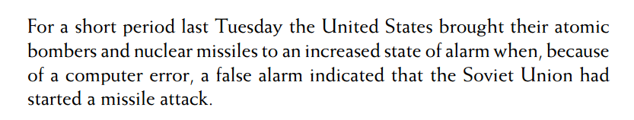
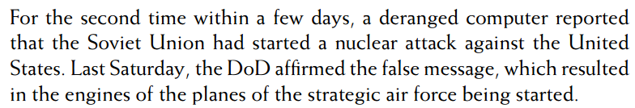
Need for Software Engineering
A (drastic) example to drive the point home – when a software issue almost led the world to the brink of war. Two newspaper clippings from June 6th and June 9th, 1980
Has anyone seen the 80s movie, War Games?
Which also reminds me, how about Kubrick’s Dr. Strangelove?
Read Software Engineering: Principles and Practices, 3rd Ed., Hans Vans Vliet for more.

Slide 39
Software Engineering Ethics
Areas where acceptable behavior might not be bound by laws, but instead by the tenuous notion of professional responsibility
Confidentiality: Respect confidentiality of employer and client whether or not a formal agreement has been signed
Competence: Don't misrepresent competence, don't accept work outside your level of competence
IPR: IP of employers and clients must be protected
Computer misuse: Don't use your skills to misuse other's computers/ systems
Organizations like ACM and IEEE have cooperated to produce a joint code of ethics and professional practice
Refer Software Engineering, Ian Sommerville, 10th Edition, Page 28, for more

Slide 40
Phases of Software Engineering (Process)
Process falls roughly under these stages:
Definition: What?
Development: How?
Maintenance: Managing change (bugs, new requirements).
Umbrella Activities: Throughout lifecycle (tracking progress, managing resources, managing documentation, reviews, measuring metrics, etc.)

Slide 41
Software Process
The systematic approach that is used in software engineering is sometimes called a software process. Four fundamental activities are common to all software processes:
Software specification, where customers and engineers define the software that is to be produced and the constraints on its operation
Software development, where the software is designed and programmed
Software validation, where the software is checked to ensure that it is what the customer requires
Software evolution, where the software is modified to reflect changing customer and market requirements
Ian Sommerville, 10th Ed.

Slide 42
Software Process
:Definition Phase: (Specification)
Requirements Definition and Analysis:
Developer must understand – Application Domain, Required Functionality, Required Performance, User Interface (might require one or several meetings with client)
Project Planning – Allocate resources, Estimate costs, Define work tasks, Define schedule
System Analysis – Allocate system resources to hardware, software, users, etc.
:Design Phase:
Software Design:
High-level Design – Define modular components (classes, interfaces), Define data structures
Detailed Design – how reach component works internally (functions/ interfaces, etc.), tables designed, Algorithm and logic design, sequence and interaction design, constraints
:Development Phase:
Coding:
Develop code for each module, Unit Testing
Integration:
Combine modules, System Testing
Notes:
High-level design says what components exist and how they interact, Detailed design says how each component works internally.

Slide 43
Software Process
:Validation:
Requirements Analysis and Test Case development, Test Case Execution and Defect Tracking
Types - System Integration Testing (how software interacts with other software); User Acceptance Testing (tests if it works as per user req.); Quality Assurance Testing (meets quality standards)
:Software Evolution: (Maintenance)
Correction – Fix Software defects
Adaptation – Accommodate changes and new features (and new company policy)
Enhancements – new features
Prevention – Identify areas to improve software and make it more maintainable
:Umbrella Activities:
Reviews – Assure Quality (Documents review, Code review, etc.)
Documentation – Improves communication across teams and maintainability
Version Control – Track changes
Configuration Management – track of various versions and associated documentation

Slide 44
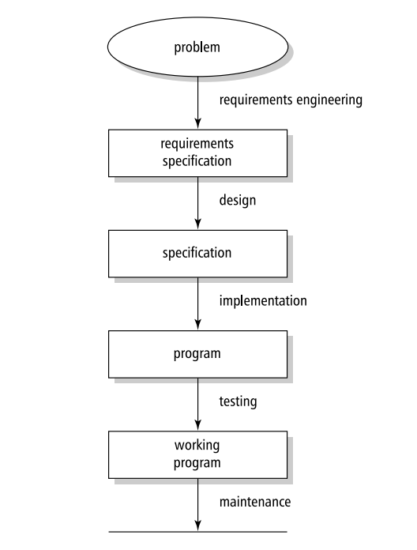
Software Process
Hans Van Vliet, 3rd Ed.

Slide 45
Issues that affect Software process
Many different types of software, no universal method for software engineering, however, following four issues can affect software, and software development:
Heterogeneity: Where the software must operate, off late software is expected to operate in a distributed fashion across various device types
Business and Social Change: Business requirements change over time, software should be able to accommodate it
Security and Trust: The more software becomes a part of our lives, the more software security and trust become important parameters to consider
Scale: Software should serve an individual, a group, or a entire nation

Slide 46
Application Types
Perhaps the most significant factor in determining the type of software engineering method applied is the type of application:
Stand-alone applications
Interactive transaction-based applications
Embedded Control Systems
Batch processing systems
Entertainment systems
Systems for modelling and simulation
Data collection systems
System of systems

Slide 47
Software Engineering Fundamentals
Some fundamental principles apply to all types of Software system, irrespective of the development techniques used:
Systems should be developed using a managed and understood development process. Of course, different types of processes are used for different types of software
Dependability and performance are important for all types of system
Understanding and managing the software specification and requirements (what the software should do) are important
When appropriate, you should reuse software that has already been developed rather than write new software

Slide 48
Case study 1 – Insulin pump control system
This is an Embedded Control System – Software Controls a hardware device and is embedded (stored in permanent memory) inside the device
Important factors in general embedded systems:
Size: Cannot to too large, since memory limited
Responsiveness: Since it is interacting with a user via a physical device, must be fast / real time (Ex: Command to display turn right on display should not happen after the lane/ road has passed by)
Power Management: Many a device run on battery, and in that case, power should be managed efficiently (Ex: In a sensor node that sends indoor temp. readings, better send data less frequently to save radio transmissions and battery)

Slide 49
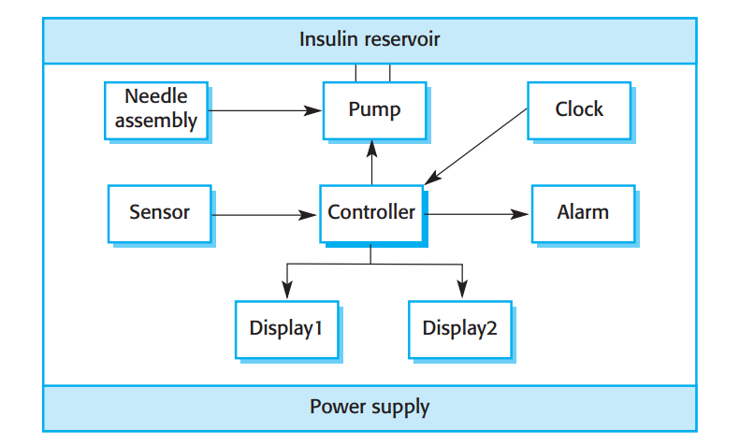
Case study 1 – Insulin pump control system
Hardware Architecture

Slide 50
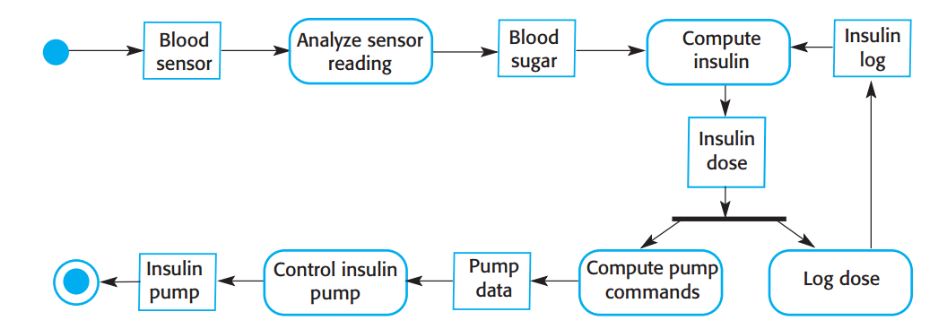
Case study 1 – Insulin pump control system
Activity Diagram

Slide 51
Case study 1 – Insulin pump control system
Important factors to consider here:
Size: Cannot to too large, since memory limited
Responsiveness: Time between sensor reading and trigger of insulin minimal
Availability: Should be monitoring round the clock
Power Management: Cumbersome to change battery so should use less power
Reliability: System should make accurate readings
High level requirements:
The system shall be available to deliver insulin when required
The system shall perform reliably and deliver the correct amount of insulin to counteract the current level of blood sugar
And more….
Notes:
What are High-Level Requirements?
High-level requirements are:
Broad, abstract descriptions of system behavior
Focused on user needs and business objectives
Independent of implementation or technology choices
They are usually defined early in the software lifecycle, during requirements analysis.
Characteristics of High-Level Requirements
Non-technical and easy to understand
Describe end-to-end functionality
Do not specify algorithms, data structures, or UI layouts
Act as a foundation for detailed (low-level) requirements
Examples of High-Level Requirements
“The system shall allow users to register and log in securely.”
“The system shall generate monthly sales reports.”
“The application shall support multiple user roles.”
“The system shall process online payments.”

Slide 52
Case study 2 – A patient information system for mental health care
Homework
Refer Ian Sommerville, Software Engineering. 10th Ed. Page 34
Read description, and list down key factors and high-level requirements of the system

Slide 53
Case study 3 – A wilderness weather station
Classwork
Role play – Mimic the people involved and the artefacts needed throughout the entire software lifecycle towards delivery of efficient working product
Will be taken up in an upcoming class

Slide 54
Thank you!

